Slide 1
The French and Indian War
Part 6- Pontiac’s Rebellion

Slide 2
Writing Roulette
Working with your partner, write a summary of the French and Indian War. You can’t talk and you have to take turns writing every other word. You have five minutes to write your summary.

Slide 3
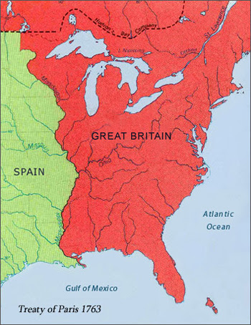
After the French and Indian War, France gave up all control they had in North America. Many French returned to France.
But what about the Native Americans?

Slide 4
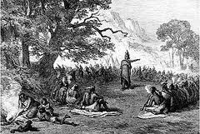
Native Americans living in the Great Lakes region and Ohio River Valley did not like the way they were being treated by the British and were afraid their land would be taken away.

Slide 5
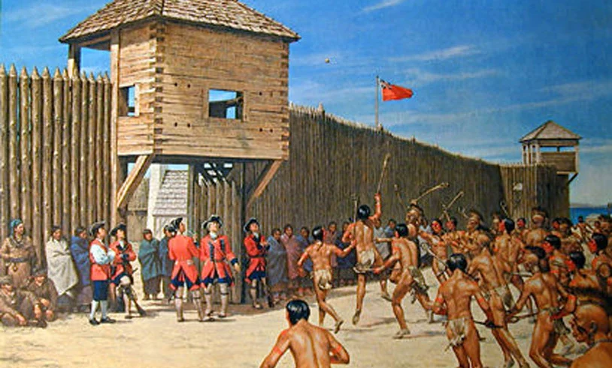
British colonists started to move into Native American territory and Great Britain stationed soldiers in many of the forts in the region.

Slide 6
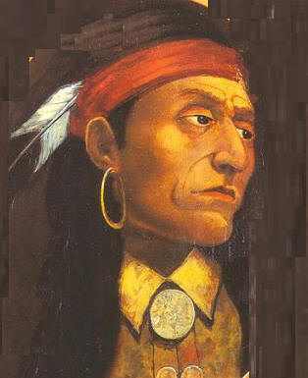
Many Native American tribes decided to join together to fight the British and colonists. One of the main leaders was an Ottawa named Pontiac. The fighting that followed is called Pontiac’s War or Pontiac’s Rebellion.

Slide 7
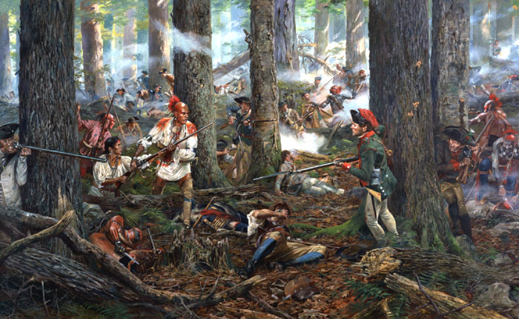
Native American warriors attacked forts, destroyed farms on the frontier, and killed many colonists living on the frontier.

Slide 8
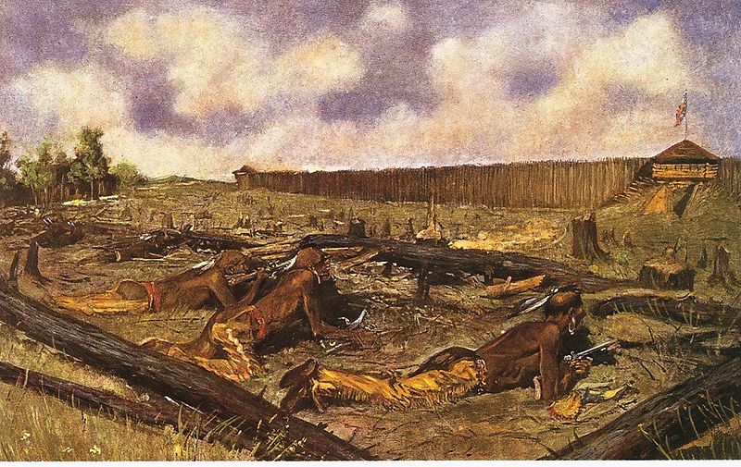
By June of 1767 only a few British forts remained in control of the British: Forts Niagara, Detroit, and Pitt were some.

Slide 10
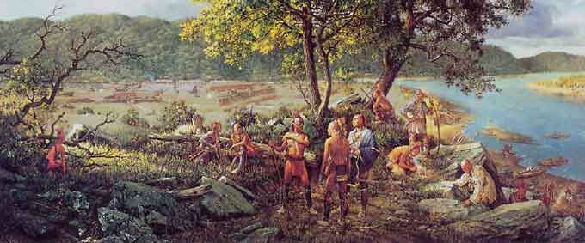
Fort Pitt was attacked by Delaware Indians on June 22,1763. They couldn’t capture the fort, so they laid siege to it.

Slide 11
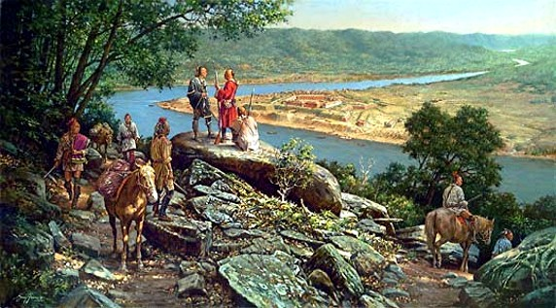
Many people from the area had fled to Fort Pitt for protection from Native American raids. The fort normally only held 300 people. During the siege, over 1,500 people sought shelter there.

Slide 12
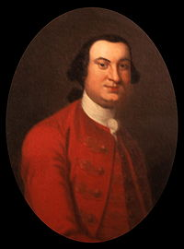
Colonel Henry Bouquet of Lancaster, along with 500 soldiers were sent to relieve Fort Pitt. The Delawares laying siege to the fort left it to attack Bouquet’s men.

Slide 13
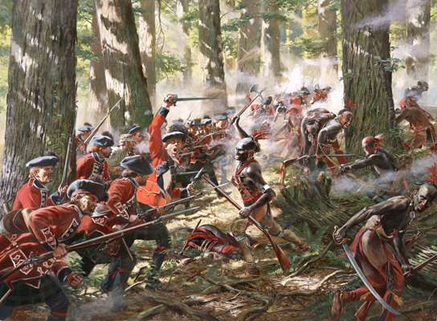
The two forces clashed on August 5, 1763, and fought the Battle of Bushy Run for two days.

Slide 14
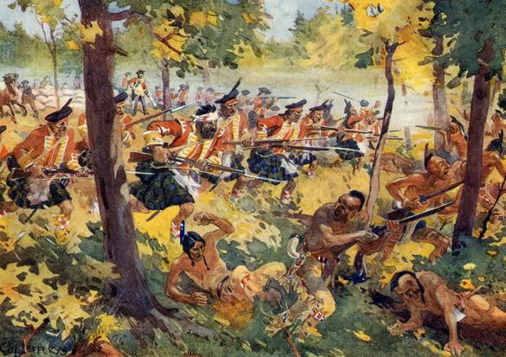
Bouquet and his men won, relieved Fort Pitt, and ended Pontiac’s War in Pennsylvania and the surrounding area.

Slide 15
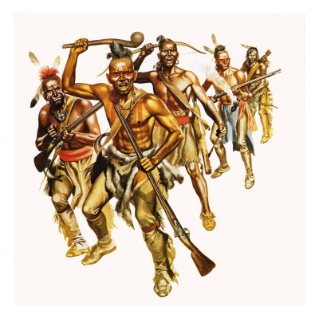
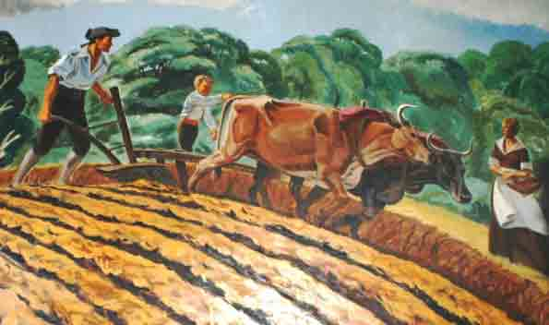
Trying to stop the trouble with Native Americans still living in the new area now controlled by England, Parliament needed a way to control their colonists and new territory.

Slide 16
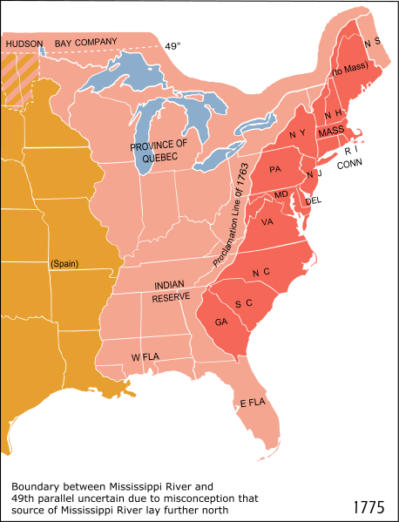
The Proclamation of 1763 was given which created a line along the frontier. Colonists were not to settle on land west of the Proclamation Line of 1763.

Slide 17
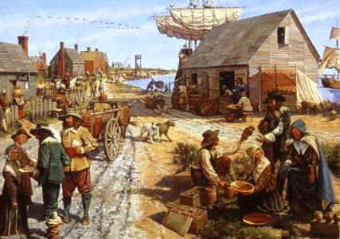
Keeping the settlers from expanding west was to also help Great Britain economically. By keeping colonists in the east, Britain’s mercantile system would continue to enrich Britain.

Slide 18
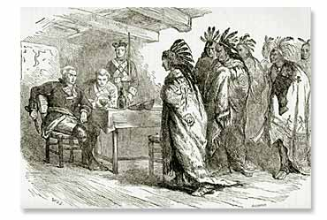
Sporadic fighting continued for two years. Pontiac had a hard time keeping his alliances together during this time. The war officially ended on July 25, 1766.

Slide 19
Results of the War
-Pontiac’s Rebellion enabled Native Americans to continue have a voice in the politics of North America during the 18th century.

Slide 20
Results of the War
-Over 450 British soldiers and 2,000 civilians were killed during the war. This led to anger towards the Native Americans and a culture of “Indian hating” in the colonies.

